Slide 1

Category Code: C3
Problem Statement Title:Creating an all-in-one platform for startups, simplifying financial planning for new enterprises, and seamlessly connecting investors with SMBs
Team Name: Job Blowers
Institute Name: Vivekanand Education Society’s Institute of Technology

Slide 2








Idea / Approach details
Problem Statement
Our proposed Solution
Finsight AI
Your New Financial
Co-Founder
FinsightAI is an AI-powered platform that simplifies financial planning for startups and connects them with the right investors.
It provides data-driven loan recommendations, cash flow management, stock optimization, and credit risk analysis, ensuring startups make informed financial decisions.
With AI-driven investor matchmaking, real-time market insights, and automated financial planning tools, startups can optimize growth while investors gain access to transparent, high-potential opportunities.
By leveraging predictive analytics, smart recommendations, and real-time alerts, FinsightAI enhances financial stability, investment success, and business growth in a rapidly evolving market.
Overwhelmed by fluctuating revenue and unclear loan terms, Rohan is unsure how to secure funding.
Frustrated by a lack of financial transparency, Nirmala struggles to find promising startups.
Rohan uses the platform to receive personalized loan suggestions, cash flow strategies, and investor matches.
Nirmala accesses AI-driven financial reports, helping her discover trustworthy startups to invest in.
Rohan secures funding, Nirmala makes a profitable investment, and the platform bridges the funding gap.
Notes:
1.7.2013
‹#›

Slide 3
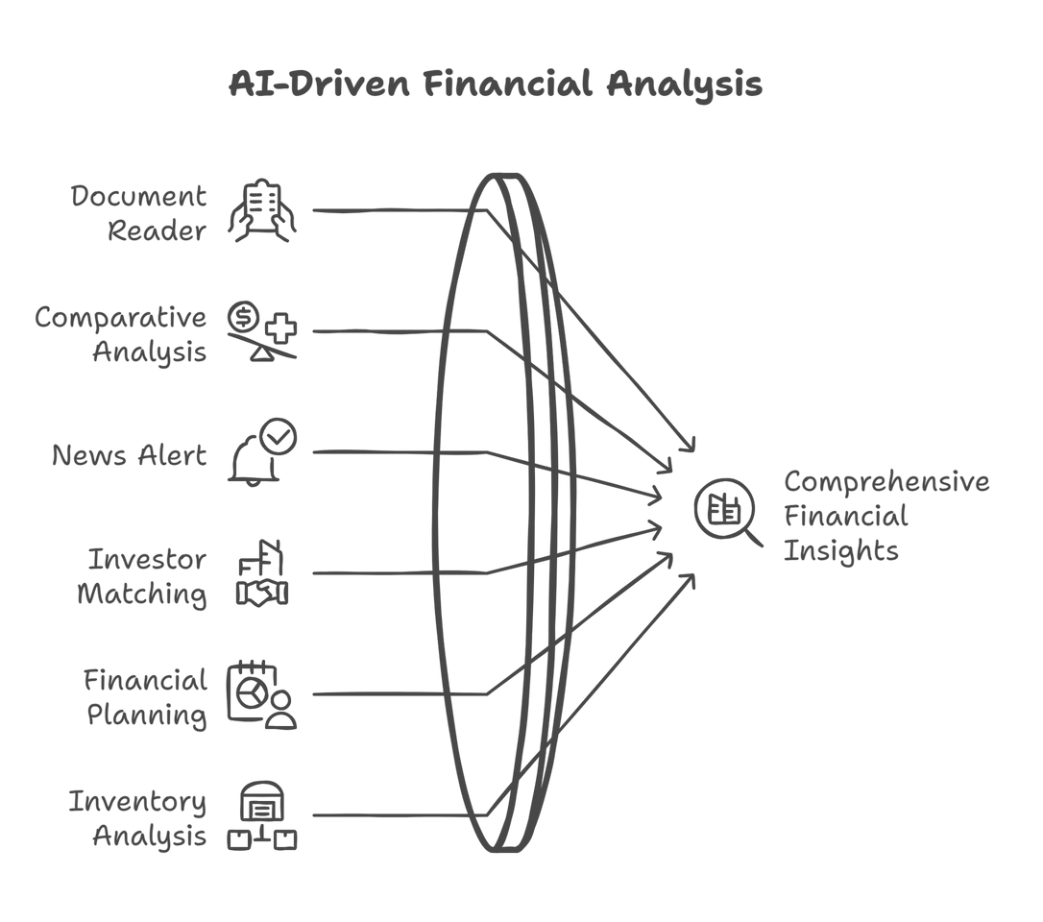
Innovation
Loan & Credit Optimization
Unlike traditional lending platforms (e.g., Kabbage), Finsight AI analyzes financial history and provides personalized loan recommendations based on AI models.Predicts credit risk and suggests strategies to improve credit scores.
Intelligent Cash Flow & Investment Management
Uses AI to predict cash surplus/deficits and suggest investment or cost-cutting measures.
Recommends short-term investments (FDs, bonds, mutual funds) for surplus funds.
Smart Stock & Inventory Optimization
Real-time stock tracking with AI-based demand forecasting to suggest optimal inventory refilling.
Analyzes supplier pricing trends to help businesses optimize costs.
Agent Backed Investor Matching
Finsight AI matches startups to investors dynamically based on historical investment patterns and startup financial health.
Personalized investment insights for investors to reduce risks.
AI-Powered News & Market Intelligence
Keeps startups updated on market trends and competitor moves in real time.
AI-curated news alerts help businesses make data-driven decisions.
Seamless Uptiq AI Integration
Uses Agent-as-a-Backend (AAB) service to dynamically generate JSON outputs and update UI in real-time.
3D Avatar-Based Chatbot Assistant
AI-powered interactive chatbot with a 3D avatar.Provides human-like conversations for financial guidance & investor queries.Integrated voice lip-syncing (VAPI) for realistic AI-driven interactions.
AI AGENT DIAGRAM
Notes:
1.7.2013
‹#›

Slide 4



Tech Stack
Connects startups and investors
Ai-driven insights for better decision-making
Helps startups plan effectively
Meeting the rising demand for funding solutions.
Partnerships with banks and other financial institutions.
S
O
SWOT
W
Earning credibility among users.
Compliance with financial laws
Highly accurate data needed for reliability.
Competition from other fintech apps.
Risk of data breaches.
T
Notes:
1.7.2013
‹#›

Slide 5

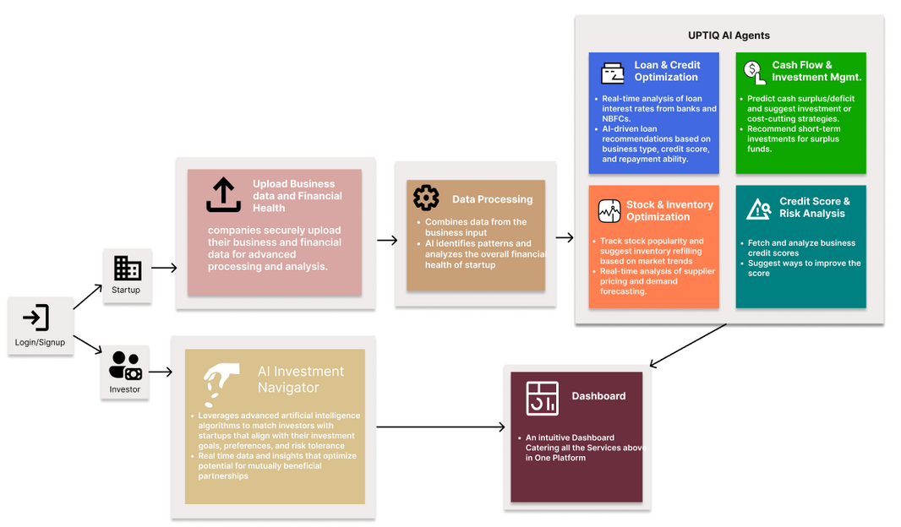
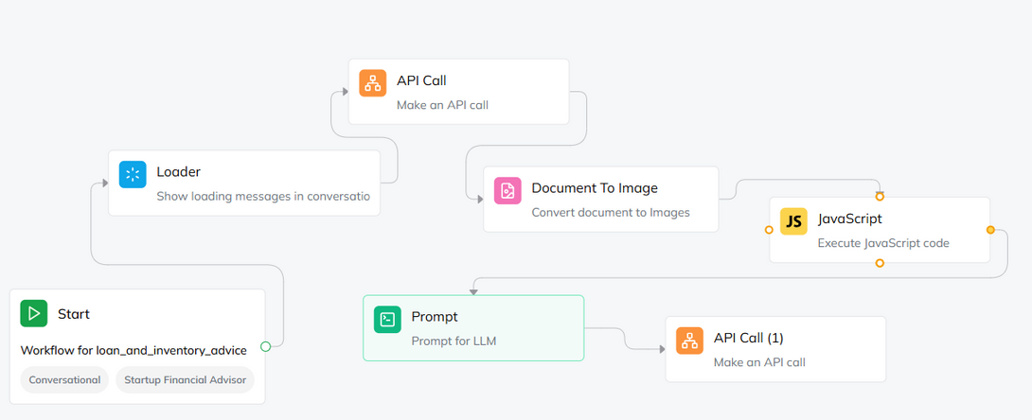
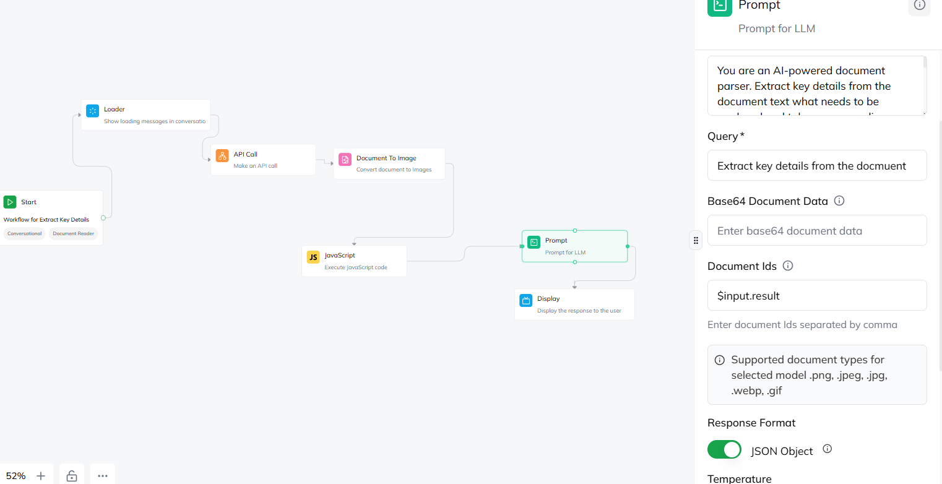
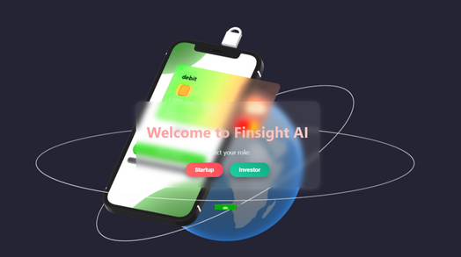
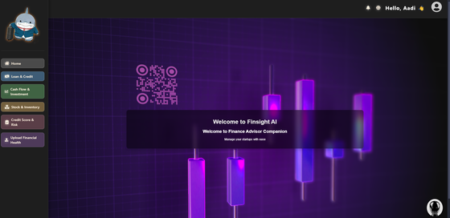
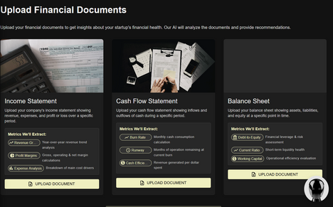
Implementation/Prototype/Use Case Diagram (screenshots)
FLOWCHART
INTENTS WORKFLOW
Workflow for Stocks and Investor Advisor, the subagent fetches data from backend, processes it and sends advisory data back to the backend so that React can fetch and display the data.
PROJECT SCREENSHOTS
Workflow for Document Upload, the subagents take 3 documents, Income Statement, Cash Flow Statement and Balance Sheet
Notes:
1.7.2013
‹#›

Slide 6

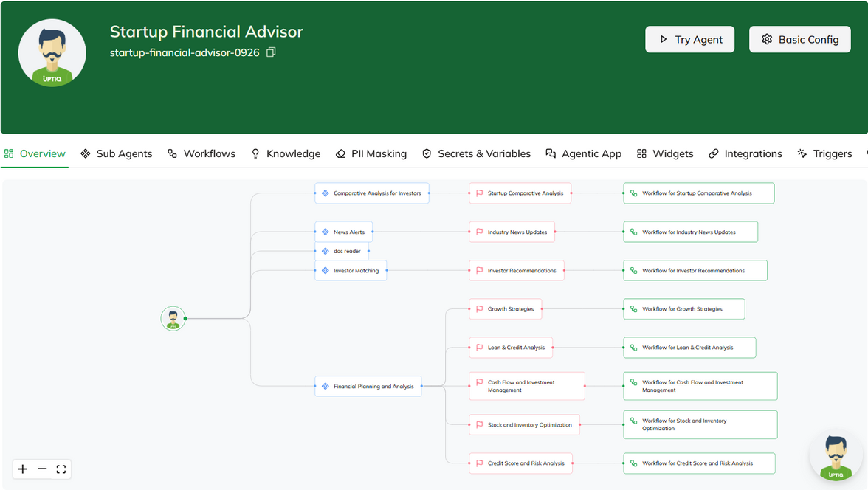
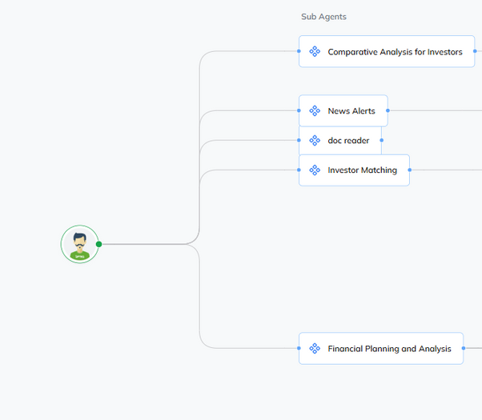
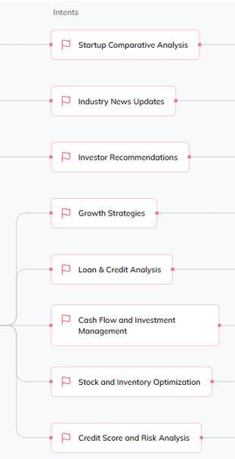
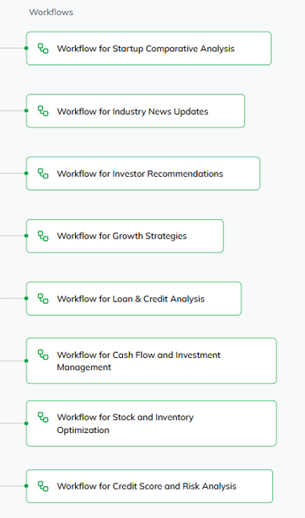
Uptiq Agents
FINANCIAL ADVISOR AGENT
Subagents:
Comparative Analysis for Investors
Output - Analyzes and compares different startups based on key financial metrics.
Parameters used : Revenue, Gross Profit, Operating Profit, Net Income
Industry News Updates
Output - Provides updates on industry trends and competitor activities to help startups stay informed.
Parameters used: Competitor Financial Moves,Market Trends,Regulatory Alerts
Investor Matching
Output - Suggests potential investors who are genuinely interested in startups, based on their investment history and habits.
Parameters used: Startup financial profile + Investor preferences
Financial Planning and Analysis
Growth Strategies - Provides recommendations based on widely implemented business strategies and guides startups in budgeting and resource management using AI-based tools.
Loan & Credit Analysis - Offers AI-driven loan recommendations, identifying banks with the best interest rates for startups.
Cash Flow and Investment Management -Predicts cash surplus or deficit and suggests investment or cost-cutting strategies, including recommendations for short-term investments like FDs, bonds, and mutual funds.
Stock and Inventory Optimization - Tracks stock popularity and suggests inventory refilling based on market trends,
Credit Score and Risk Analysis - Fetches and analyzes business credit scores and optimizes them.
The Agent is modularized into 6 Sub-Agents, each with their own feature. There are a total of 14 intents
AGENTS ANALYSES THESE METRICS BY THESE FOLLOWING DOCUMENTS
1) INCOME STATEMENT
2) CASH FLOW STATEMENT
3) BALANCE SHEET
4) MARKET DATA THROUGH HISTORICAL DATASET
Notes:
1.7.2013
‹#›

Slide 7
Future Objectives
SEAMLESS WORKFLOW INTEGRATION -
INVESTORS AND STARTUPS CAN COMMUNICATE, SCHEDULE MEETINGS, TRACK PROGRESS,AND SHARE DOCUMENTS EFFORTLESSLY
CROSS-BORDER STARTUP FUNDING -
BLOCKCHAIN-BACKED MULTI-CURRENCY TRANSACTIONS WITH REGULATORY COMPLIANCE.
BLOCKCHAIN-POWERED FUNDING & COMPLIANCE -
SMART CONTRACTS FOR SECURE, AUTOMATED, AND TRANSPARENT FUNDING.
PITCH DECK
PITCH DECK THAT PROVIDES INSIGHTS INTO PRESENTATIONS AND FINANCIAL OVERVIEWS FOR INVESTORS
Notes:
1.7.2013
‹#›

